Slide 1
LAB 1
Installation of Linux (Ubuntu)
Instructor
Aliza Saeed

Slide 2
Linux (Ubuntu) Installation

Slide 3
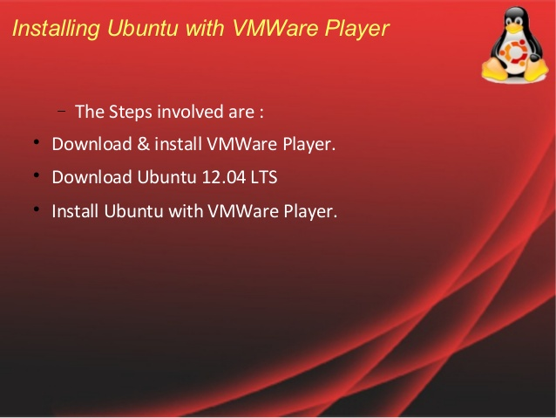

Slide 4
Linux (Ubuntu) Installation
VMware, Inc. is a subsidiary of Dell Technologies that provides cloud computing and platform virtualization software and services
Was the first commercially successful company to virtualize the x86 architecture

Slide 5
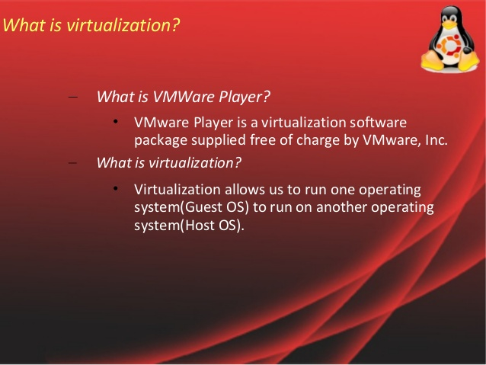

Slide 6
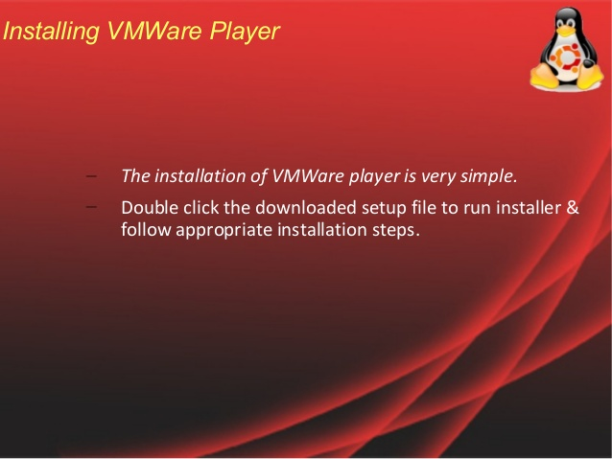

Slide 7
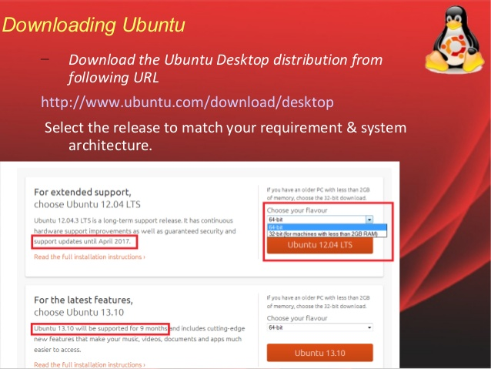

Slide 8
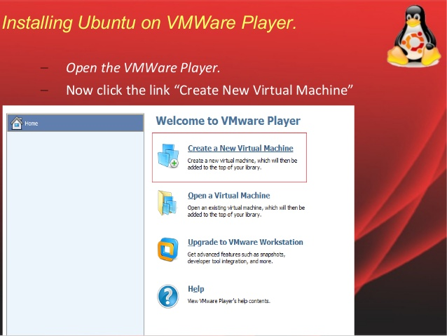

Slide 9
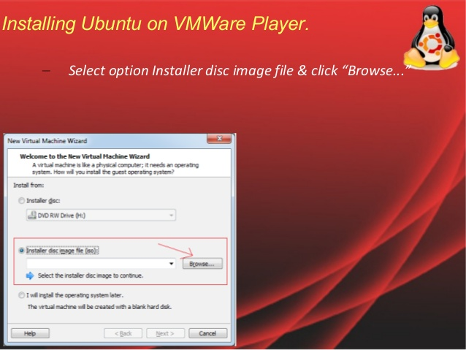

Slide 10
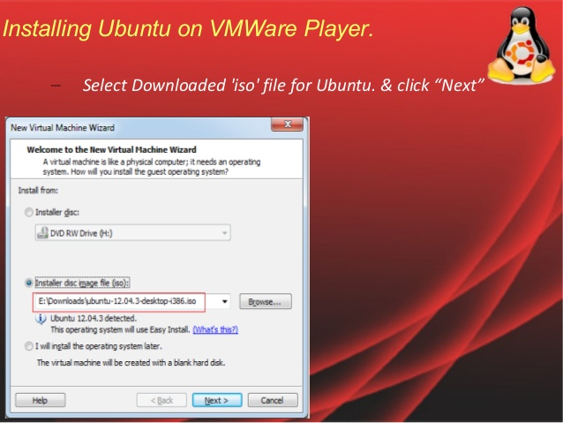

Slide 11
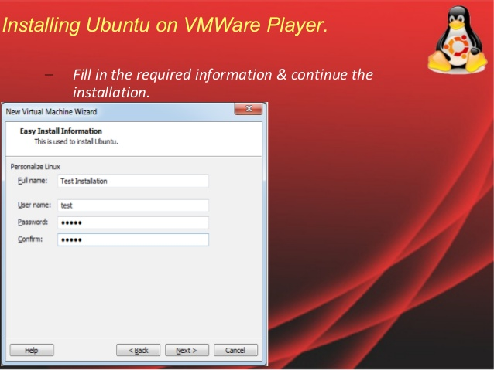

Slide 12
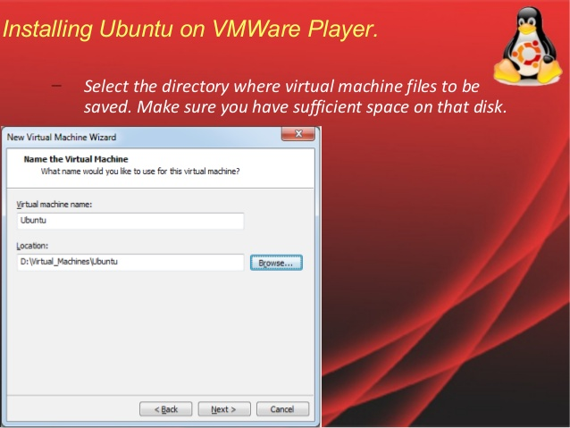

Slide 13
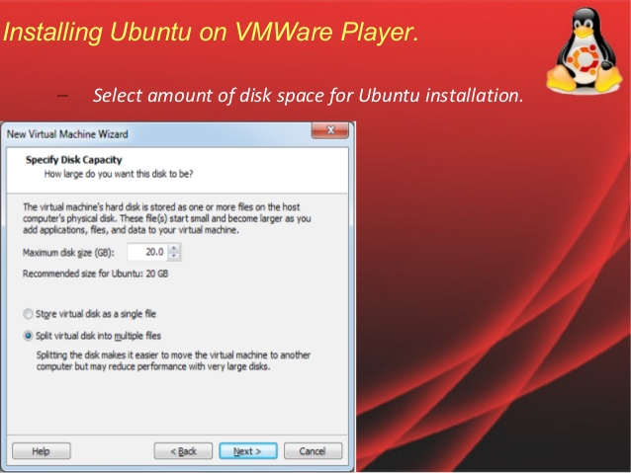

Slide 14
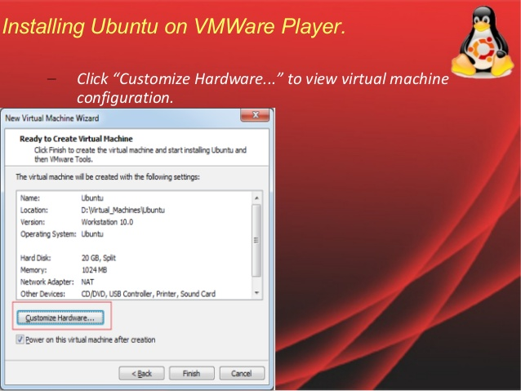

Slide 15
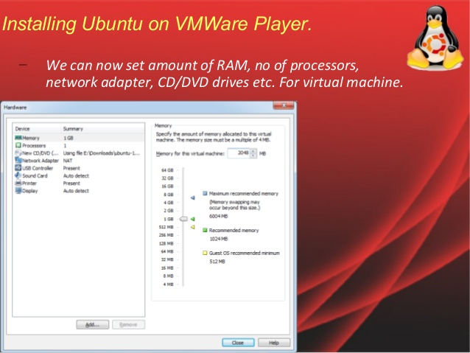

Slide 16
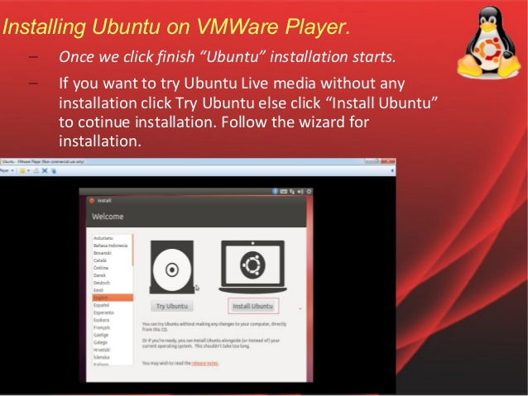

Slide 17
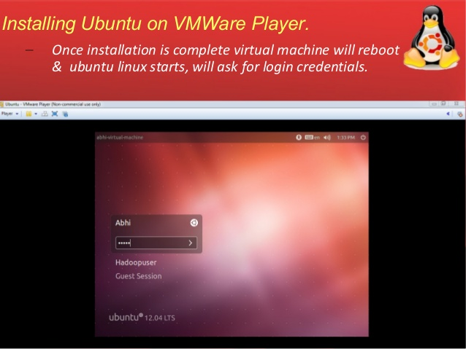

Slide 18
